Slide 1
English
Lesson 1

Slide 2
Hello, everyone!
How are you?
Do you like staying at home? Is it strange that we don’t go to school every day? What do you think?

Slide 3
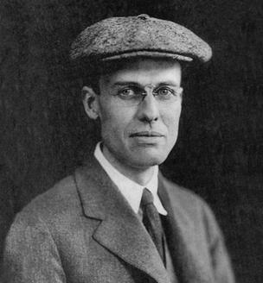
Sometimes I feel as if I live inside a painting by Edward Hopper. He was an American painter.
You can find information about him here: https://kids.kiddle.co/Edward_Hopper
Source: https://en.wikipedia.org/wiki/Edward_Hopper

Slide 4
A lot of his paintings show people inside rooms. Click on the link below to see some of them. What are the people in the paintings doing?
https://www.educaplay.com/learning-resources/5297658-what_are_they_doing.html
What do you think of the paintings? Which one do you like the most?

Slide 5
Remember?
We use the Present Continuous Tense to talk about something that is happening NOW.

Slide 6
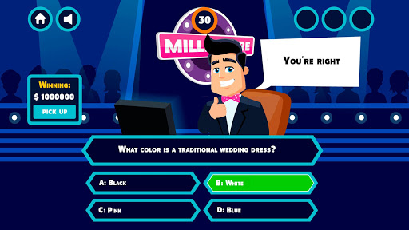
Let’s play a game, shall we?
Click on the link below to play “Billionaire”. You can play as many times as you wish!
https://www.eslgamesplus.com/action-verbs-present-tenses-esl-interactive-grammar-vocabulary-game/
Do you like it?
Source: https://lh3.googleusercontent.com/iZHlSdON2ZJD9mTS38mgXSdFKujzh5alKrJKp7HM0sjWo4DSoZM6up5U5S27TNcTYKg

Slide 7
Your turn now!
Let’s make our own paintings! Choose a room in your house and observe the people in it. What are they doing? Keep notes and when you are ready try to paint them in that room. You can even make a little sketch of yourself too!
It doesn’t have to be as realistic as Hopper’s paintings are.
It can be messy or funny. It’s your painting!

Slide 8
Before we go…
Since we spend so much time indoors we might as well play one more game for today! Click on the link to begin.
Oh! And don’t forget: ΜΕΝΟΥΜΕ ΣΠΙΤΙ
https://www.jigsawplanet.com/?rc=play&pid=3e197408957f *
*Οδηγίες: Κάνω κλικ στον σύνδεσμο που βλέπω. Βάζω τον κέρσορα πάνω σε κάθε κομμάτι και το σέρνω για να φτιάξω το παζλ.

Slide 9
Bye bye!

