Slide 1
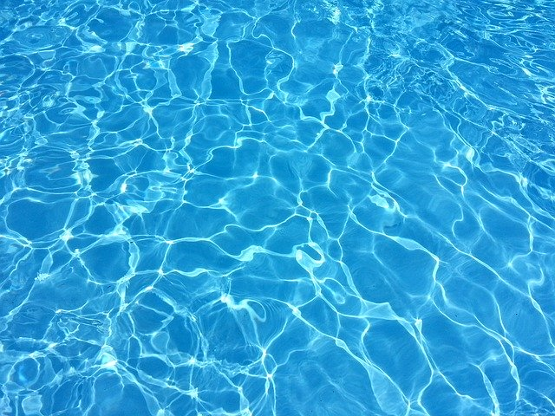
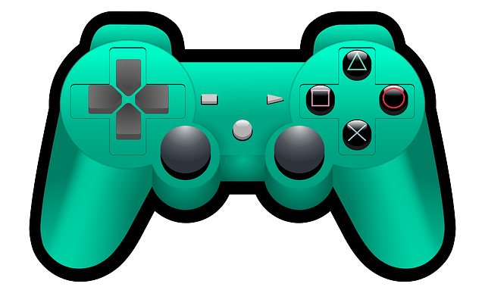
Hello!
Do you remember time prepositions?
Click on the pictures below.

